Slide 1
Using the Camera
IN721 2017
Design and Development for Mobile Devices
Session 11.2
Notes:
We have talked often about the importance of having actual mobile use cases when you write mobile apps.
One of the clearest situations is when you want to use hardware that mobile devices have, but desktop devices do not – e.g. the camera and the GPS chip.
In our next two sessions we will look at how to access and communicate with these hardware devices programmatically.
Today, the camera

Slide 2
Using the camera
Coding options
Launch an intent that starts the on-board camera app.
Write your own low-level code to control the camera device.
Development options
Using the emulator
Using a real device
Connected, from Android Studio
Unconnected, with simple deployment
Notes:
We are only going to cover the first technique.
It works well, fits the Android philosophy and is recommended by the developer group.
I mention the second possibility so that you will know it is there. It’s not especially difficult and uses only things you know (custom classes, fragments, etc.), but it’s currently in a state of upheaval. The old camera class was deprecated and replaced with a new one just in the most recent Android version, and that new one is buggy and almost certainly going to change in the next version.
If down the road you need custom camera control, see the docs at that time.
For development, this is where the emulator hits a realism barrier. It does have a simulated camera and it’s pretty effective, but it’s not the same as an actual phone with an actual camera.
So as part of this topic, we will look at how to use an actual phone.
We will consider how to make AS talk to a phone that’s connected to the computer, and then we will look at how to get an app installed onto a phone via email. This is not how you would deploy for a commercial release, but the it makes no difference to the phone, and is much more straightforward.
We will consider deployment to the Play Store later in the semester, if there is time.

Slide 3
Camera via Intent
Process:
Set up
Create a unique file name and path for your image
Create the appropriate file
Create an Intent to launch the camera app
Assign your file to the Intent
Launch
Launch the intent with startActivityForResult. This transfers control to the camera app.
Callback
Write an onActivityResult handler to run after control is returned to your app.
Notes:
Let’s look at the interesting coding issues in these steps.

Slide 4
Set up: Create a unique file for your image
Use internal app storage.
Call openFileOutput()
developer.android.com/training/basics/data-storage/files.html
Use the system image directory
Environment.getExternalStoragePublicDirectory(Environment.DIRECTORY_PICTURES);
Include WRITE_EXTERNAL_STORAGE permission in AndroidManifest.xml
Notes:
Let’s look at the interesting coding issues in these steps.
You can use your apps own storage, as shown. See docs for detail
Or, you can use the system image directory. The impact of this is that images taken will available to other image apps like the Gallery.
NB: They don’t become available immediately, only when crawled by the MediaScanner service. You can force this crawl programmatically if you wish. Left as an exercise.
The call to getExternalStoragePublicDirectory returns a File object.

Slide 5
Set up: Create a unique file for your image
Get the image root path
Create a sub directory for your app
Generate a time stamp
Build the complete path name
Create the file in the sub directory
Notes:
Here are the steps
Let’s look at one code solution...

Slide 6
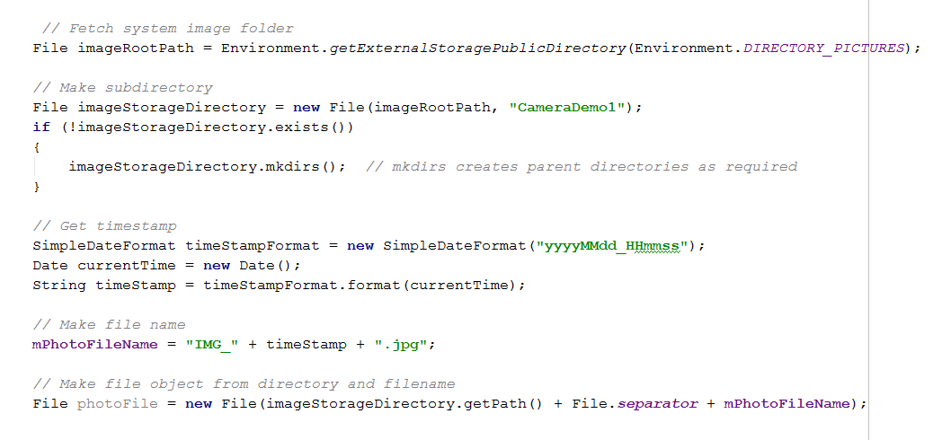
Set up: Create a unique file for your image
Notes:
There are other options for the filename.
Just make something unique.
It would be sensible to put this code into a method that returns the file.
Whenever you need a new unique file (i.e. You are about to launch the camera), call the method.

Slide 7
Launch: Start the camera app via intent
Generate a URI from your file object
Create an implicit Intent with input argument ACTION_IMAGE_CAPTURE.
Use putExtra to attach the URI to the Intent. Use the MediaStore.EXTRA_OUTPUT system key.
startActivityForResult
Notes:
Here’s some code that will work

Slide 8
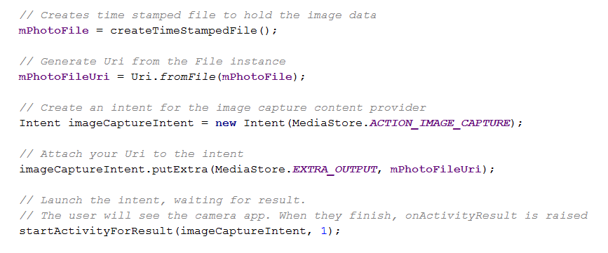
Launch: Start the camera app via intent
Notes:
Assume I put the code for the file creation into a method.
To launch, do this...

Slide 9
Callback: Write onActivityResult
onActivityResult is raised after the user takes a picture and saves it (from inside the onboard camera application)
In your onActivityResult handler, you can fetch the image from memory and use it.
Notes:
You should remember that to define code that should be executed when startActicvityForResult returns control, you override onActivityResult.
Let’s look at the fetching process...

Slide 10
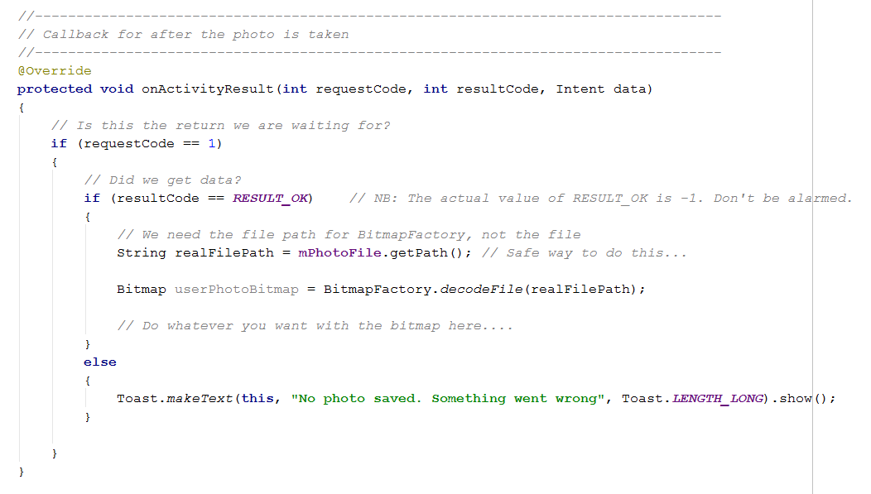
Callback: Write onActivityResult
Notes:
Let’s look at the fetching process...

Slide 11
Important Technical Note
If the user rotates the phone while using the camera, your app may crash.
Caused by the “tear-down” cycle.
To prevent tear-down on rotation, add this attribute to your Activity in the manifest:
android:configChanges="orientation|screenSize"
Notes:
The default behaviour of Android apps is to destroy and recreate the Activity whenever the configuration – including orientation -- changes.
Thus rotating the phone kills your current Activity instance and creates a new one. But startActivityForResult needs to return control to the original (now destroyed) Activity. So the app crashes.
You can add this attribute to prevent this behaviour.
This is a very crude solution, and is not recommended for professional app building. Unfortunately, the method recommended for professional app building is very complicated, so we will just do this for now.
We will discuss dealing with lifecycle events and saving state in a later lecture.
You have now seen all the pieces for using the camera from inside your app. In the practical, you will have a chance to put them together.
First though, we need to talk about setting up the emulator and/or hardware devices to allow you to run your app on them.

Slide 12
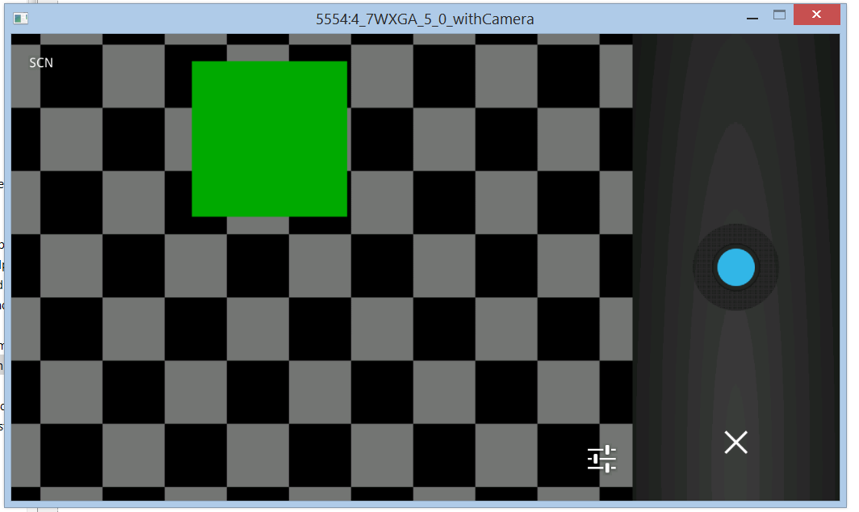
Emulator Camera
Notes:
Before starting, get into the advanced settings for your emulator in the AVD and make sure it has a camera.
When you launch the camera app on the emulator, it launches an emulated camera app, as shown.
The square moves slowly around, bouncing off the walls. It changes colour periodically between green and red.
When you tap the shutter button, it grabs the state of the screen.
This allows you to confirm that it is actually “taking the picture” at the moment you hit the shutter.
That’s all you have to do.
In theory. In practice, I have found the emulator to be quite buggy in this area. Definitely fewer headaches with a real device.
So....

Slide 13
Using a real phone with AS
Using the phone with AS.
Reveal the Developer Options menu item
Enable Developer Options -> USB Debugging.
Connect phone to computer via USB
Install drivers if you must
Phone appears in AVD run list.
Notes:
So the emulator camera is sufficient for development, but a real phone is more fun.
You can use the phone as the device AS runs your code on. You still have access to the debugger, logcat, etc., the thing just runs on the phone instead of on the emulator.
You can also use the phone by installing your app on it and running it just as normal for any app. To do this, you have to compile your project to an installable form.
We’ll go through the first process; the second will be left as part of the practical (but if people have trouble with it, we can go through it together in class next week.)
Note that some people report problems with getting the phone to appear that can be resolved by turning USB debugging off and turning it back on again with the phone connected.

Slide 14
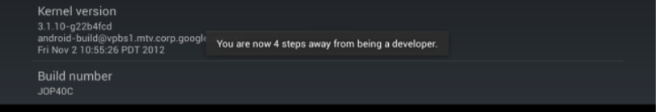

Using a real phone with AS
Reveal the Developer Options menu item
Settings->More->About Device
Scroll down to Build Number
Tap Build Number seven times (this is not a joke)
Notes:
This applies to the Galaxy S3 running 4.3.
Different versions have the Settings arranged differently, so you may have to hunt around for the Build Number..
Developer Options is now available in Settings->More

Slide 15
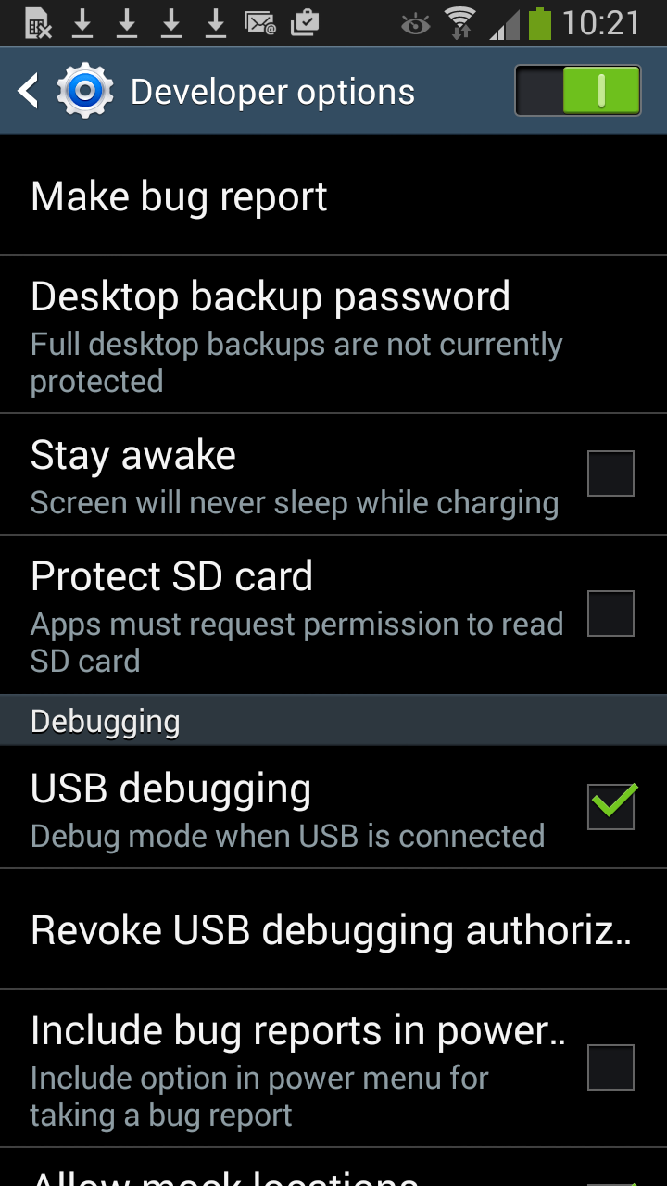
Using a real phone with AS
Notes:
Turn on USB Debugging...

Slide 16
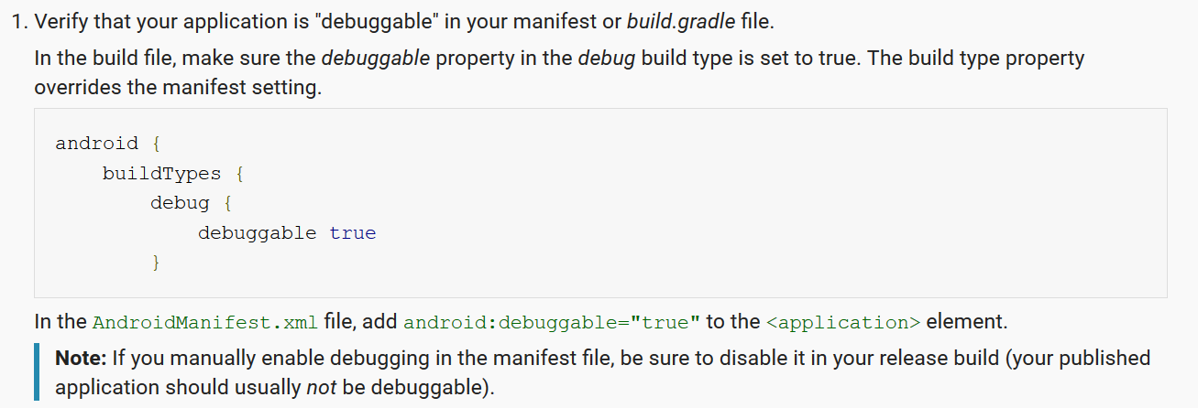
Using a real phone with AS
Technical note:
http://developer.android.com/tools/device.html
Notes:
The docs say this is required.
I’ve actually run on the phone without it, but it’s worth being aware of.
In fact, you should read this whole module to learn more about using AS with a real device.

Slide 17
Deploying to a real device
Generate a signed .apk (see docs)
Email it to the user
When the user opens the email attachment, they will be prompted to install.
After installation, the app works as normal.
developer.android.com/tools/publishing/app-signing.html
Notes:
AS is set up nicely for this.
Basically all you do is select the appropriate menu item and provide a path and password for a keystore file.
It does all the rest.
No difference between an app installed this way and one that comes from Play Store.

Slide 18
Practical 11.2 – Photo Mosaic
IMPORTANT
Please do this practical first using API 21.
Set at creation, or in build.gradle (Module: app)
minSdkVersion 21
targetSdkVersion 21
After it is running, you may optionally roll it up to 23+, and add the new permissions model code.
Notes:
We want to concentrate on the camera here, not the permissions model
Roll back to 21, where all you need is the uses-permissions in the manifest.

Slide 19
Practical 11.2 – Photo Mosaic
Build an application that lets the user take a photo, which is then displayed as a 4-tile mosaic.
Test your application both with the emulator and with a real Android device.
Notes:
If you don’t have a device to use, you can borrow the school’s S3.

Slide 20
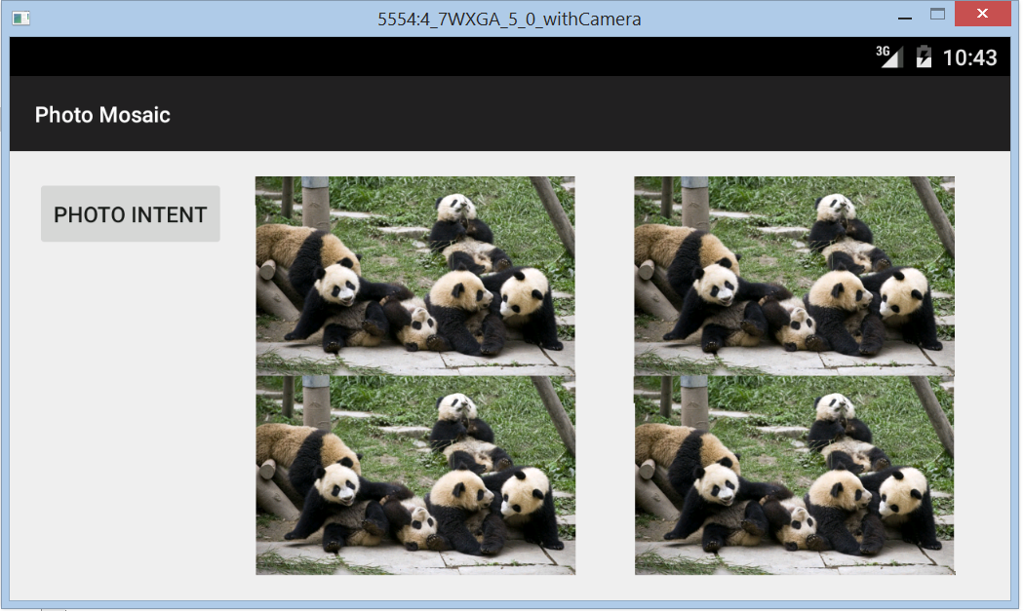
Practical 11.2 – Photo Mosaic
Opening Screen
Notes:
Four ImageViews show the user where the mosaic will appear.
Build this app to default to landscape mode. This will look better.

Slide 21
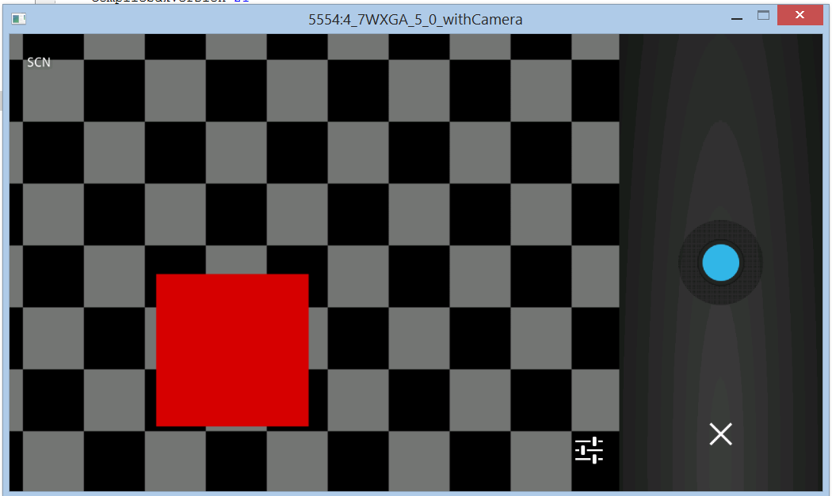
Practical 11.2 – Photo Mosaic
Running on the emulator
Notes:
Running on the emulator, the camera app has been launched...

Slide 22
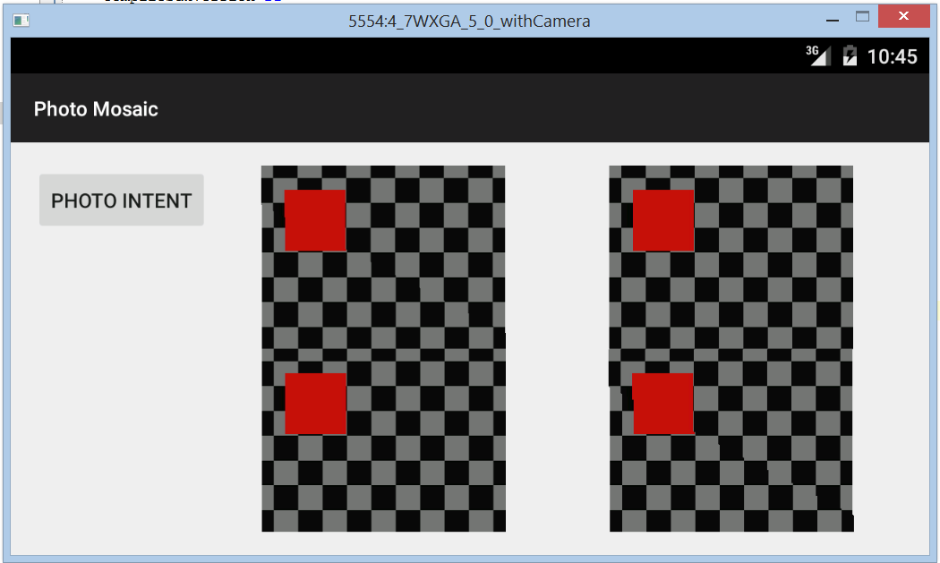
Practical 11.2 – Photo Mosaic
After image taken
Notes:
The user hit the shutter button and saved the photo.
They now see this....
The four ImageViews all filled with their picture.

Slide 23
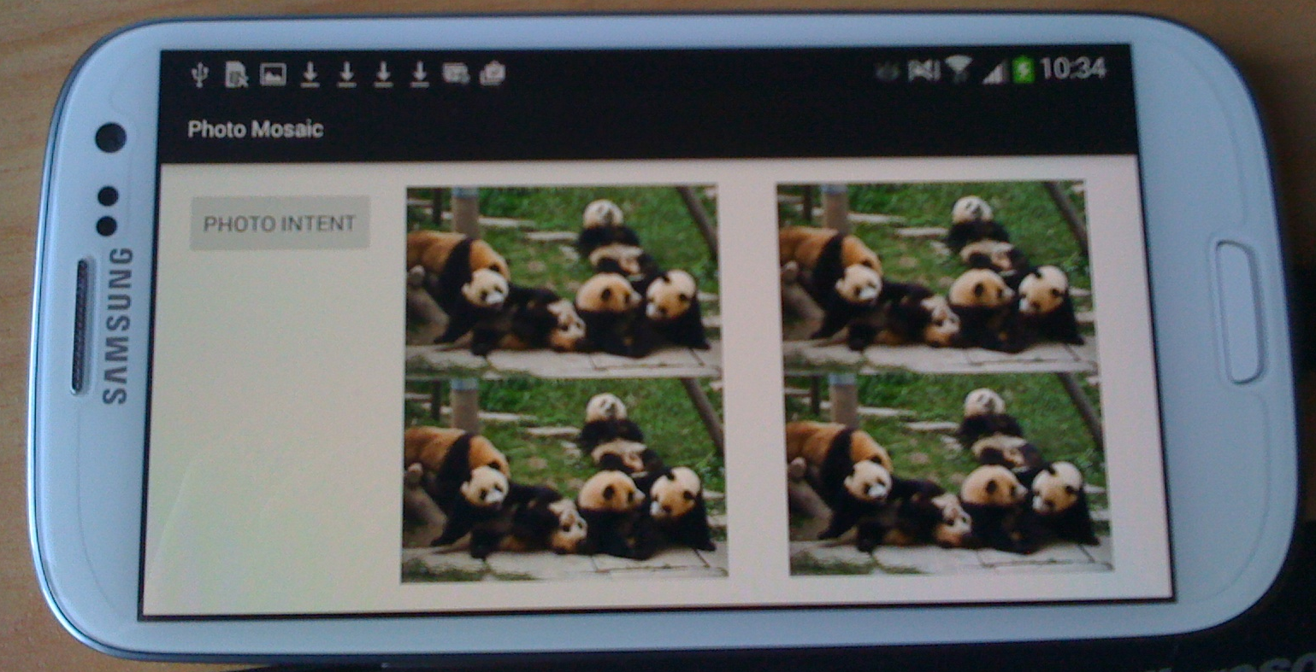
Practical 11.2 – Photo Mosaic
Opening screen running on a phone
Notes:
Running on a phone....
Pressing the button drops you into the normal camera app
Take and save an image and...

Slide 24
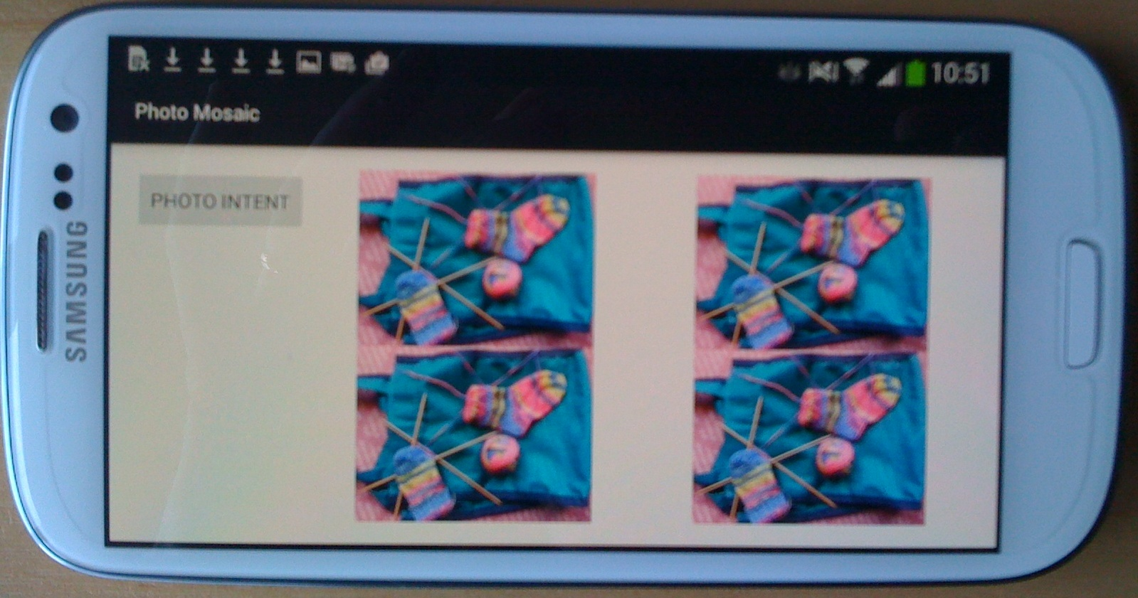
Practical 11.2 – Photo Mosaic
After image taken
Notes:
...it looks like this

Slide 25
Technical Note
If your images are too large, Android will not load them correctly into your ImageViews.
No error is thrown; your ImageViews are just empty.
Suspect this problem if you can see your images from inside the debugger, but they don’t display on the screen.
Reduce the fetched bitmap (using the appropriate static method of the Bitmap class) before assignment to the ImageView.
Notes:
This depends on how many pixels your camera is producing.
In the demo, the images are reduced to 627 x 390.

